Slide 1
Predicting Taxi Journey Times
Notes:
Welcome to section 3.
In previous sections we’ve used a number of pre-trained models and algorithms to develop our solutions. In this section, we’ll be taking tackling a much harder problem of predicting taxi journey times.

Slide 2
What we will cover in this section
A summary of the problem
How we will approach it
Environment and dataset
Exploring our data
Training our model
Testing our model
Notes:
This slide, like mentioned above is for multiple pointers. The information above covers the types of information that can be used in this slide
https://aws.amazon.com/blogs/machine-learning/build-your-own-face-recognition-service-using-amazon-rekognition/

Slide 3
3.1 Summary of the Problem
Notes:
In this section we are going to look at some of the computer vision and AI technology used in self driving cars, specifically an approach to predict the steering angle based on a feed of images of the road ahead.

Slide 4
A summary of the problem
Predicting journey times is a common use case for transport companies
It is inherently difficult to do due to noisy data, varying conditions, etc.
We want to predict a reasonable approximation of the time
Notes:
We see this use case in many areas, most notably those that use Uber will see that they try to predict how long it will take for an Uber to reach you, and also how long the journey will take. On most situations, they provide a range of times as the conditions on the road are always varying and inherently impossible to predict.
If we assume we have a dataset of historic taxi journeys, we will know pick up and drop off locations and times, the fares, the distance of the journey, etc. It may also be possible to get a reasonable approximation of the weather conditions too.
However, it may be that drivers take different routes based on their local knowledge, or because something happens at that moment (an accident, a build up of traffic, the lights change at the certain moment, a truck reverses from a side road). No data set could ever hope to cover all of these situations for every single trip, so we are therefore unlikely to build a perfect model.
What we can achieve though is to take these factors and create a model that gives a reasonable approximation of the journey times between different locations, and that’s what we’ll do in this module.

Slide 5
How we will approach it
We will use open data provided by New York City (NYC)
NYC provides taxi journey and weather data going back many years
Using this data, we’ll develop features that enrich that data and thereby enhance a model’s ability to learn
We’ll build a neural network that learns from this data in order to predict subsequent journeys

Slide 6
Environment
This model requires a powerful PC with a GPU, or use of a cloud GPU instance
The dataset is large and needs at least 8GB of memory to pre-process
It took many hours to train to a level where the predicted durations were reasonably accurate
Please check Python version compatibility with Tensorflow!
Notes:
I did most of this work on a Macbook pro with 8GB of memory. It enabled me to tune the model on slices of the data, but in order to train the final model I moved to the cloud (in my case I used a Google cloud VM with 2 cores, 13GB of memory and an Nvidia K80 GPU). Even this took circa 8 hours to train to a reasonable level of accuracy.
If you don’t have access to this level of compute power, the trained model is included along with the code so you can still work through this section and understand how the model was trained.

Slide 7
Dataset
Working with yellow cab taxis in New York City
https://goo.gl/maps/JLf7EkCzGsP2
A full set of taxi trip data for several years is available here:
http://www.nyc.gov/html/tlc/html/about/trip_record_data.shtml
We will work with June 2018 data for this section
The relevant datasets are included in the repo with the code
Notes:
As mentioned, NYC provides significant volumes of data from historical taxi journeys for yellow cabs, green cabs and private hire companies such as Lyft and Uber. We’ll be working with June 2018 data for Yellow taxis. This alone is in the region of 8m rows of data.
The total data for the 12 months starting June 2017 was over 110m rows, and when looking at this, I needed a server with 48GB of memory to do any meaningful manipulation of it!
As the datasets for trip data and weather are on different websites, the necessary files are made available as part of the repo along with the code.

Slide 8
3.2 Exploring the data
Notes:
In this video, we’ll look at the 3 different datasets that we’ll use and how we are going to link them together to train our model.

Slide 9
What we will cover
Trip data
Taxi zone data
Weather data
Bringing these together
Feature engineering
Notes:
The 3 datasets that we’ll use are the trip data from yellow taxis in June 2018, the taxi zone data, which I’ll explain shortly, weather data, how we bring these together to make samples to train our network, and some we’ll touch on feature engineering.

Slide 10
Let’s explore the dataset…
Notes:
As you can see, a large percentage of the dataset has a steering angle of between -5 and +5 degrees. This can potentially cause training issues where the algorithm may get 70% accuracy by just returning 0 as the answer! Obviously this won’t be a good thing in a real car!!

Slide 11
Feature Engineering
One-hot (categorical) encoding
Days of the week can be labelled 0 – 6 (or 1 – 7), or we can encode them:
Monday (1) : [1, 0, 0, 0, 0, 0, 0]
Friday (5) : [0, 0, 0, 0, 1, 0, 0]
Creating new features
We’ll create a Euclidean distance feature
Image courtesy of Wikipedia https://en.wikipedia.org/wiki/Euclidean_distance
Notes:
Due to the size of the dataset, we will create some ‘new’ features for our model. These are in 2 forms:
One-hot, or categorical encoding.
Here you can see how we encode the day of the week in a vector. Monday would perhaps set the 1st value to 1, Friday the 5th, etc.
This helps algorithms determine the importance of the particular days of the week to the journey times, perhaps Monday to Friday’s have longer durations due to increased traffic for workers.
The 2nd approach is to create a new feature altogether. Although the dataset contains a distance column, this is the distance taken by the taxi and we won’t know this in advance. So we’ll create a Euclidean distance feature that is the straight line distance between the pick-up and drop-off locations.
Also, as you’ll recall from exploring the dataset, we only have the zones for pick up and drop off in the more recent NYC data, so we are using the centre of those zones as the pick up and drop off locations (again note that this will increase the inaccuracy of our model, how do we know where in those zones the journey started or stopped, it could be the near side, the far side of each, or somewhere in the middle).

Slide 12
3.3 Training Our Model
Notes:
In this section we are going to look at some of the computer vision and AI technology used in self driving cars, specifically an approach to predict the steering angle based on a feed of images of the road ahead.

Slide 13
Training our model
Creating training, validation and test datasets
Keras neural network definition
Generators
Analysing our model’s performance
Notes:
This slide, like mentioned above is for multiple pointers. The information above covers the types of information that can be used in this slide

Slide 14
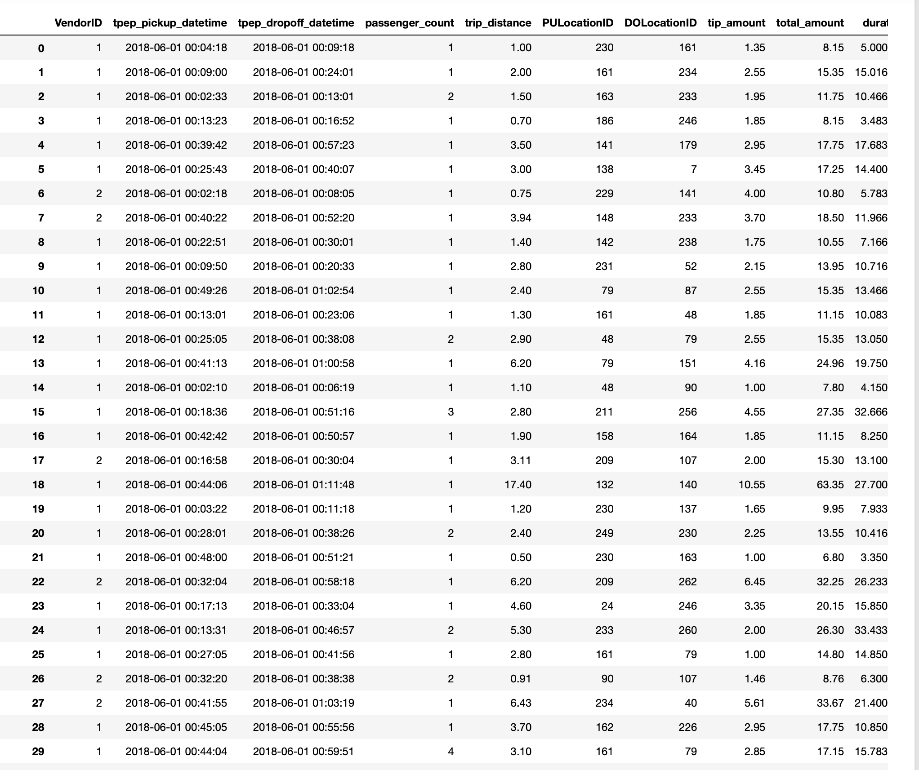
Splitting our data into train, validate and test datasets
Training Samples
Validation Samples
Test
Samples
Notes:
For this exercise, I’ve split the data using a typical approach.
60% of the data is for training
20% for validation (which is to help the training algorithm)
20% is kept out for testing our model (we’ll use this in the next video).
This slide shows an example of what this would look like. Obviously our real data is circa 8m rows long and contains more columns (or features) than are displayed here.

Slide 15
Generators
As our dataset is large, we don’t want to load it all into memory
Generators give us the ability to iterate through our dataset and train on batches
Notes:
As our dataset is large, we don’t necessarily want to load it all into memory in one go, or even pass it to the neural network in one go. We’ll use Keras generators to split the data up into batches and feed it to the network as and when the training algorithm needs more samples.

Slide 16
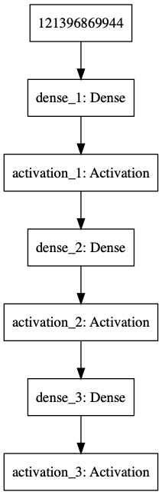
Our CNN
Sample
Prediction of Trip Duration
Notes:
Our neural network is quite simple in comparison to some that are widely used. It has 3 layers, an input layer connected to a fully connected (or dense) layer of 1024 neurons, a 2nd layer with 128 neurons (again fully connected) and a final output layer.

Slide 17
Let’s explore the code…
Notes:
As you can see, a large percentage of the dataset has a steering angle of between -5 and +5 degrees. This can potentially cause training issues where the algorithm may get 70% accuracy by just returning 0 as the answer! Obviously this won’t be a good thing in a real car!!

Slide 18
Debugging Neural Networks
Training neural networks can be more trial-and-error than science
Prove the code works by running a small number of samples and a single batch
Train using a small number of samples to check that the model converges and you see overfitting
Increase the number of samples over time
Make changes to the network architecture, hyper-parameters, etc. to find an optimal solution
Then scale to the full dataset
See https://keras.io/getting-started/faq/#why-is-the-training-loss-much-higher-than-the-testing-loss
Notes:
This is the approach I use for training neural networks. Typically I would perform the initial training and tuning locally to ensure the code is working and the model is starting to converge or a small number samples before moving to a cloud based server to train on the full dataset.

Slide 19
Analysing Training Performance
We are looking for the [training] loss and validation loss to decrease over time

Slide 20
3.4 Predicting Journey Times
Notes:
In this section we are going to look at some of the computer vision and AI technology used in self driving cars, specifically an approach to predict the steering angle based on a feed of images of the road ahead.

Slide 21
Testing Our Model
Testing model accuracy to see how it performs
Notes:
This slide, like mentioned above is for multiple pointers. The information above covers the types of information that can be used in this slide

Slide 22
Let’s explore the code…
Notes:
As you can see, a large percentage of the dataset has a steering angle of between -5 and +5 degrees. This can potentially cause training issues where the algorithm may get 70% accuracy by just returning 0 as the answer! Obviously this won’t be a good thing in a real car!!

Slide 23
How to make it better?
Perform more in depth investigation to the data
Use a larger dataset
Augment the data
Add additional features
Notes:
Some of the things that could be done to improve the model would be:
We could look for patterns over time, for example journeys between certain zones may contain less accurate (or more variable) data
Sample previous years’ data where the actual geolocations of pickup and drop-off are used, this may give us a more accurate view of where in the zones a journey may start and stop
Use a larger dataset covering more months and years
Augment the data, for example find datasets containing time and date of accidents or major public events like concerts
Look for patterns at different times of the day, perhaps creating features to identify rush hour

Slide 24
Predicting Steering Angles
Next Video
Notes:
In the next video we’ll look at another type of neural network and how it can help us predict steering angles for a self-driving car.

